Slide 1
UNIT-III
Memory Management

Slide 2
MEMORY MANAGEMENT
Introduction to Memory
Memory is an essential part of computer system as both CPU and I/O devices accessing. Due to this reason, we should try to efficiently manage the memory for maximum utilization of computer system.
The part of the operating system that manages the memory is called memory manager.
Its job is to keep track of which part of memory are in use and which parts are not in use,
Allocate memory to the programs when they need it, deallocate memory when the programs completes the execution and
To manage swapping between main memory and disk when the main memory is not big enough to hold all the processes. Memory Management system can be divided into two classes.
When O.S fetch data from secondary memory to Main memory the allocation of space is done in 2 ways
Contiguous allocation
Non contiguous allocation

Slide 3
Contiguous Allocation
Multiprogramming with fixed partitions (MFT)
In this the user memory is divided into definite areas called partitions, the number and size of each partition is fixed.
If there are 4 partitions which are of sizes 2k, 7k, 9k, 12k then the no. of partitions and size of each partition cannot be changed during the life of the system.
The size of each partition is determined by making a study on the length of incoming jobs. The incoming jobs are constantly monitored and allocation is done in a partition where it approximately fits in.
J5 J4 J3 J2 J1
12K | 10K | 6K | 8K | 5K
O.S
2K | P1
7K | P2
9K | P3
12k | P4

Slide 5
Let us assume there are 5 jobs in job Queue as shown in the above fig.
Job 1 can be fit in any one of the partitions P2, P3. P4.
However, If Job 1 is fit in P3. P4 partitions then the internal fragmentation are more.
Hence Job 1 is stored in partition P2 and there is an internal fragmentation of 2k,
Job2 is stored in partition P3 and producing an internal fragmentation of 1k.
Job3 is stored in partition P4, producing an internal fragmentation of 6k. There are two ways of storing Job3 in memory.
Store Job3 in partition P4 producing large amount of internal fragmentation.
Make Job3 wait until partition P2 is free
Once the Job completed execution, then the respective partition is freed. If we assume that Job3 is stored in partition P4 then the remaining two Jobs Job4 and Job5 cannot be stored in any partition because all the partitions P2. P3, P4 are occupied with some Jobs.
Here Job4 and Job5 are made wait until the partitions P4 is free. When partition P4 is free, then Job4 goes to partition P4 after completion of it, Jobs goes to P4. Here partition P1 is not allocated to any Jobs

Slide 6
Since there is no Job of size less than or equal to 2K in the Job queue. Therefore entire partition P1 is empty and this is called external fragmentation.
MFT suffers from both internal fragmentation and external fragmentation. Fragmentation is defined as waste of memory space. Internal fragmentation is defined as waste of memory space in a partition
Example - Let there be a partition of size 10K and the program of size 9K is allocated to that partition. Then internal fragmentation of 1K (10K-9K) this 1K cannot be allocated to any program. Since one partition should contain only one program.
External fragmentation is defined as wastage of memory space in the entire partition.
Example :- Suppose there is partition of size 2K but there are no Job in the Job queue of size less than or equal to 2K then the entire 2K partition left empty. This called external fragmentation.
There is major disadvantage in MFT is that if there is a program of size 15K which cannot be allocated in any partition then the system fails to allocate memory for that program. To overcome this disadvantage we use MVT.

Slide 7

Multiprogramming with Variable Partition (MVT):
In MFT too much of memory is wasted when program sizes are smaller than partition sizes i.e. There is an internal fragmentation in MFT.
Also if there is a program of size 25K, but there are no partitions of size greater than or equal to 25K then memory cannot be allocated for this 25K program.
To overcome this disadvantage MVT is used.
In MVT partitions are not static i.e. partitions are created dynamically.
The memory has a whole is considered as a single partition i.e. initially, in MVT, the entire memory is considered as a single partition is called HOLE.
Let us assume the memory size is 256K. O.S. Occupies 40K (Say). Then the remaining 216K is left for user programs. This entire 216K is treated as a single partition.

Slide 8
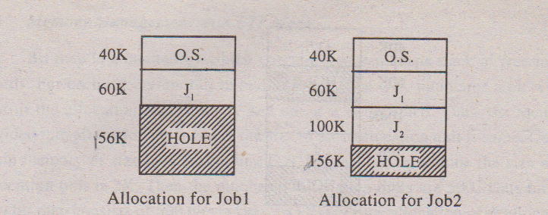
Let us assume there are 5 Jobs with sizes shown below:
Now the 216K hole is divided into two partitions. Where one partition contains J1 and second partition is a hole of size 156K. Thus memory is divided into partitions based on the sizes of the Jobs. This is called dynamic partitioning. The memory allocation for Jobs is done as follows
Job | Sizes
J1 J2 J3 J4 J5 | 60K 100K 70K 30K 80K

Slide 9
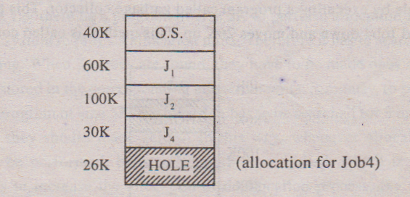
Allocation for Job3 cannot be done since program of size 70K is greater than hole size.
The Jobs J3 and J5 cannot be accommodated in memory since there is no Hole of enough size. This means J3 and J5 have to wait until any one of the Jobs present in main memory completes execution. Thus MVT memory management is as follows.
When a Job arise and needs memory, operating system searches for a Hole which is large enough to accommodate the Job, if it finds one, memory is allocated by dividing the hole into two partitions where one partition is accommodated for Job and second partition is left empty to satisfy the future request.
MVT also suffers from external fragmentation. In the above fig. the 26K cannot be accommodated for any Job present in the Job queue. Therefore, this 26K is external fragmentation.

Slide 10
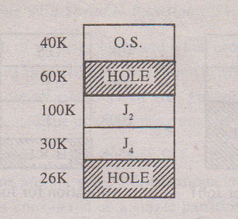
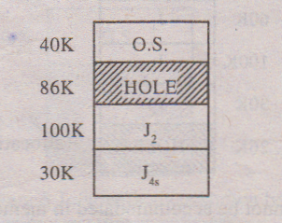
Suppose J1 completes execution, then it leaves memory and the 60K becomes a hole.
Thus we have two non-adjacent Holes of sizes 60K and 26K.
Neither J3 nor J5 can be accommodated in these Holes (without combining).
Suppose if these holes are adjacent to one another then we get a single large hole of size 86K and allocation can be done for Job3. But presently these two holes are non adjacent.
Hence operating system combines these two non adjacent Holes into a single large hole by executing a program called garbage collector. This program relocates Job2 and Job4 down and moves 26K up. This method is called compaction.
Now allocation for Job3 is done in 86K hole. Compaction is a time consuming process i.e. Executing garbage collector requires considerable time. Hence compaction should be employed only if it is necessary.

Slide 11
Swapping in Operating System
Swapping is a memory management technique and is used to temporarily remove the inactive programs from the main memory of the computer system.
Any process must be in the memory for its execution, but can be swapped temporarily out of memory to a backing store and then again brought back into the memory to complete its execution.
Swapping is done so that other processes get memory for their execution.
Basically, low priority processes may be swapped out so that processes with a higher priority may be loaded and executed.

Slide 12
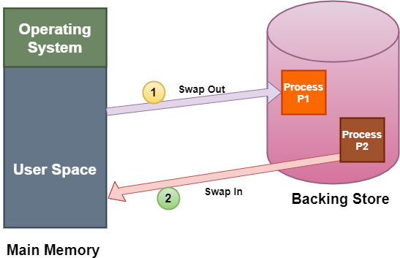
Let us understand this technique with the help of a figure given below:
The above diagram shows swapping of two processes where the disk is used as a Backing store
In the above diagram, suppose there is a multiprogramming environment with a round-robin scheduling algorithm;
whenever the time quantum expires then the memory manager starts to swap out those processes that are just finished and swap another process into the memory that has been freed.

Slide 13
A variant of the swapping technique is the priority-based scheduling algorithm.
If any higher-priority process arrives and wants service, then the memory manager swaps out lower priority processes and then load the higher priority processes and then execute them.
When the process with higher priority finishes .then the process with lower priority swapped back in and continues its execution.
This variant is sometimes known as roll in and roll out.
There are two more concepts that come in the swapping technique and these are: swap in and swap out.
Swap In and Swap Out in OS
The procedure by which any process gets removed from the hard disk and placed in the main memory or RAM commonly known as Swap In.
On the other hand, Swap Out is the method of removing a process from the main memory or RAM and then adding it to the Hard Disk.

Slide 14
Advantages of Swapping
The advantages/benefits of the Swapping technique are as follows:
The swapping technique mainly helps the CPU to manage multiple processes within a single main memory.
This technique helps to create and use virtual memory.
With the help of this technique, the CPU can perform several tasks simultaneously. Thus, processes need not wait too long before their execution.
This technique is economical.
This technique can be easily applied to priority-based scheduling in order to improve its performance.

Slide 15
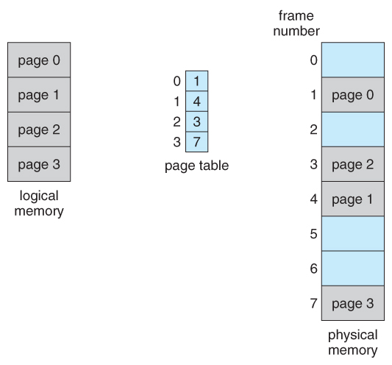
Paging
In paging the process is divided in to no.of partitions called pages(Logical Memory). The size of each page must be same.(if page0 size is 1KB,remaining page size should also be 1KB)
Main memory(Physical Memory) is divided into no. of partitions called Frames. The Size of each frame must be same.
The page size and Frame size must be equal
Whenever CPU needs to executes a process then the pages of the process from S.M are loaded in to frames of the main memory.
Page table accepts page number as the input and produces Frame no. as the output.
Figure 8.11 - Paging model of logical and physical memory

Slide 16
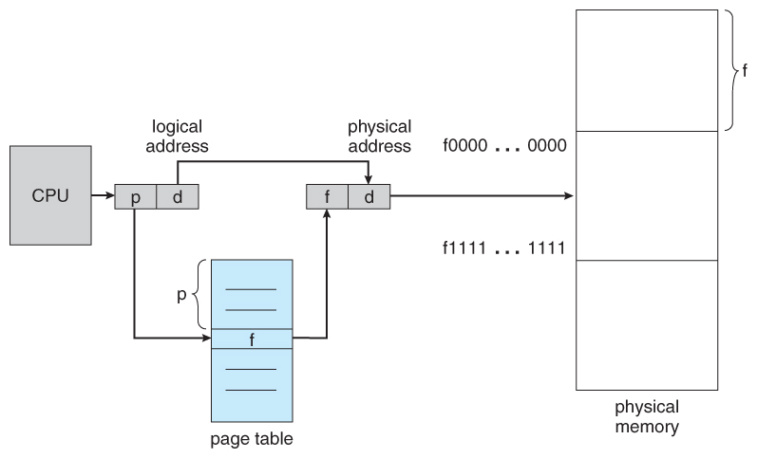
Paging Hardware.
In order to execute any address CPU generates logical address
Logical address is divided in to two parts
Page number
d(Page offset) or displacement(location within the page)
The page no. is given as input to page table .
Page table accepts page no. as the input and it produces frame no. as the output
If we combine frame number with offset then it will give exact physical address in the main memory.so CPU executes corresponding instruction which is available at this address

Slide 17
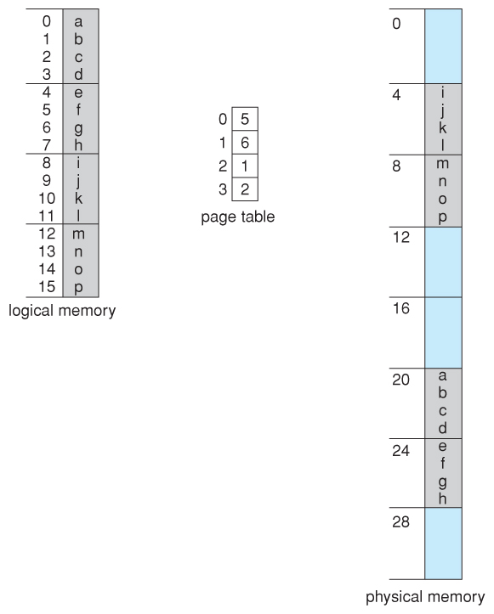
Paging example for a 32-byte memory with 4-byte pages
The Size of the page is 4 bytes so size of the frame will also be 4 bytes (8 Frames 8*4=32))
Displacement = logical address - (starting address of the page where the address falls)
Now the memory manager checks in which frame the page is falling and finds the physical address.

Slide 18
Logical address 0 is page 0, offset 0. Indexing into the page table, we find that page 0 is in frame 5. Thus, logical address 0 maps to physical address 20 [= (5 x 4) + 0].
Logical address 3 (page 0, offset 3) maps to physical address 23 [ = (5 x 4) + 3].
Logical address 4 is page 1, offset 0; according to the page table, page 1 is mapped to frame 6. Thus, logical address 4 maps to physical address 24 [ = ( 6 x 4) + 0].
Logical address 13 maps to physical address 9.
Implementation of Page table
It is not possible to store page table in register because registers will be of small size. We should keep page table in main memory.
If we store P.T inside M.M then the problem is we require two memory accesses for accessing an instruction.one memory access for accessing the P.T and another memory access for access in the M.M.
We need to have two memory accesses for execute single instruction.
For executing single instruction instead of one memory access we need to have two memory accesses.

Slide 19
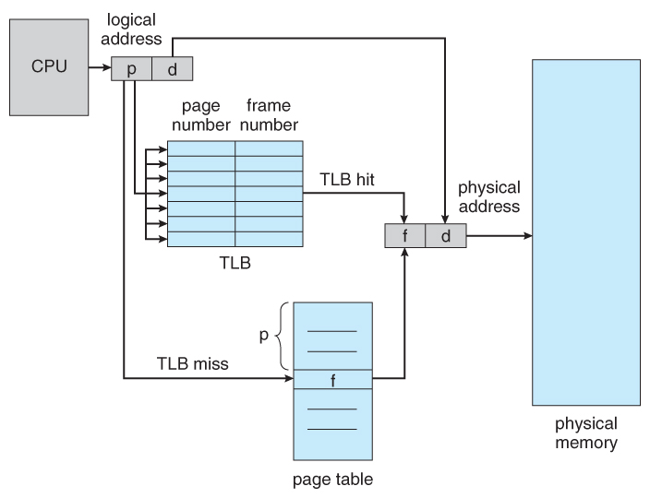
In order to overcome this problem, we uses a faster, smaller cache called translation look-aside buffer, TLB.
TLB is an associative memory. In A.M information is stored in the form of tags where each tag is represented in the form of pair
The first component of the pair is key
The Second Component of the pair is value.
Paging Hardware with TLB

Slide 20
TLB mainly contains the most frequently accessed entries of page table.
Let Page table contains 1000 pages out of those 1000 pages let we are accessing 10 pages more frequently.
So TLB contains those 10 pages
The most frequently accessed pages will kept in TLB.
Addresses are first checked against the TLB, and if the info is not there ( a TLB miss ), then the frame is looked up from main memory and the TLB is updated.
If the TLB is full, then replacement strategies range from least-recently used, LRU to random.
The percentage of time that the desired information is found in the TLB is termed the hit ratio.
For example, suppose that it takes 100 nanoseconds to access main memory, and only 20 nanoseconds to search the TLB.
So a TLB hit takes 120 nanoseconds total ( 20 to find the frame number and then another 100 to go get the data ), and a
TLB miss takes 220 ( 20 to search the TLB, 100 to go get the frame number, and then another 100 to go get the data. ) So with an 80% TLB hit ratio,
Tthe average memory access time would be:
0.80 * 120 + 0.20 * 220 = 140 nanoseconds

Slide 21
Segmentation
Segmentation is mainly useful in order to maintain modular structure of the Program.
The major drawback of paging is , In Paging a Modules may reside in diff pages of the process.
Ex: Let us take C Program, it consists of functions. Let we have 3 functions deposit(),Withdrawal(),Cancel().so total our process contains 3 functions.
Here there is a possibility that deposit() may store in diff pages of a process. let it occupy 3 pages. withdrwal() may reside in 10 pages of a process.
In paging we are not maintain any modular structure.
Modular structure means each partition should contain only one function. In paging same method may reside in multiple pages of a process and multiple frames of the memory.
So, In order to overcome that problem We uses Segmentation.

Slide 22
Segmentation is Non- Contiguous memory allocation
Segment is a method or collection of statements, Generally function is called as segment
Here memory allocation for segments is same as paging
Here given process is divided into a number of partitions. Here size of a partition is equal to size of segment.
Suppose segment size is 10kb then 10kb of partition is allocated for segment.
Here the logical memory is a collection of segments. Each segment is identified by segment. Number and length of segment. The logical address is divided into two
Though logical address is two dimensional, actual physical memory is one dimensional.
Hence they should mapping from two dimensional logical addresses (user defined address) into one dimensional physical address.
This is done by using segment table.
Each entry of the segment table contains segment base (starting address of segment) and segment limit (length of segment).
Whereas CPU generates a logical address, the displacement of logical address must be less than the segment limit. If it is not then a trap sent to CPU indicating it is invalid address and the program execution stops.
If displacement is <segment limit then it is valid address. Hence the logical address must be converted into physical address.
Physical address = Displacement + segment base.
Segment No. | displacement

Slide 23
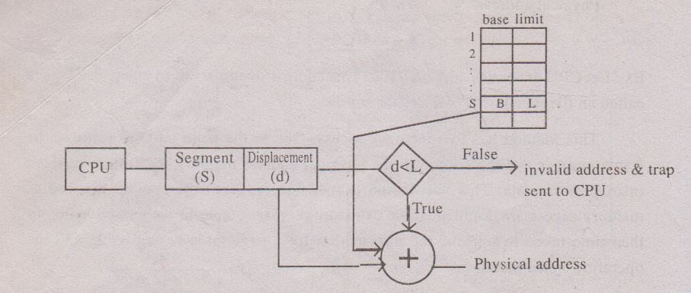
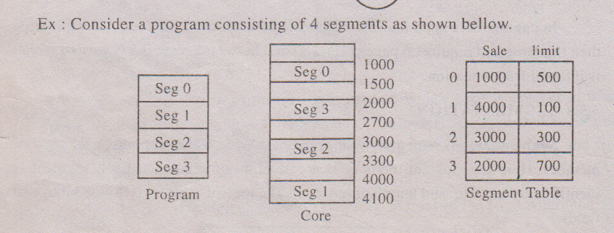
Ad

Slide 24
Let the logical address be 1, 53. First we have to check whether this address is valid address or not. Compare the displacement 53 with segment 1 limit 100. Since 53<100 the address is valid.
Physical address = 53 + segment base
= 53+4000
= 4053
Let the logical address be 2,310. First we have to check whether this address is valid or not. Since 310 > seg2 limit 300. So the address is invalid and hence trap is sent.
From the above example we notice that, the segments are of unequal lengths where as in paging all pages are of equal lengths.
In segmentation there is no internal fragmentation, because the segment lengths are not predefined, where as in paging there is internal fragmentation because the page lengths are predefined
Both paging & segmentation suffers from external fragmentation. A segment is made to wait until sufficient memory available. Like paging, in segmentation also the memory accessed two times. One for segment table to retrieve base and limit and second for physical address memory location to retrieve information. Hence operating speed goes down.

Slide 25
Structure in Page table.
Mainly there are three types of Page tables
Hierarchical paging or Multi level paging.
Hashed Page table
Inverted page table.
These page tables are mainly useful when a page table contains lakhs of Entries.
Hierarchical paging or Multi level paging.
If we want to store lakhs of entries in a page table then we use Hierarchical paging,
Let us assume that size of Logical Address is 32 bits
Whereas size of the page is (Page size): 4KB
2² 2¹⁰ = 2¹²
So page may contains 2 ¹² locations.
LA 32 bits
So Size of the page No. is 20 bits. And size of offset is 12 bits.
Totally we can store 2²⁰page numbers in a page table. 2 ²⁰ means 10,lakhsi,e we have to store 10 lakhs entries in a page table. The entire page table is stored in M.M,for accessing the M.M we need more access time.
P(20) | d(12)

Slide 26
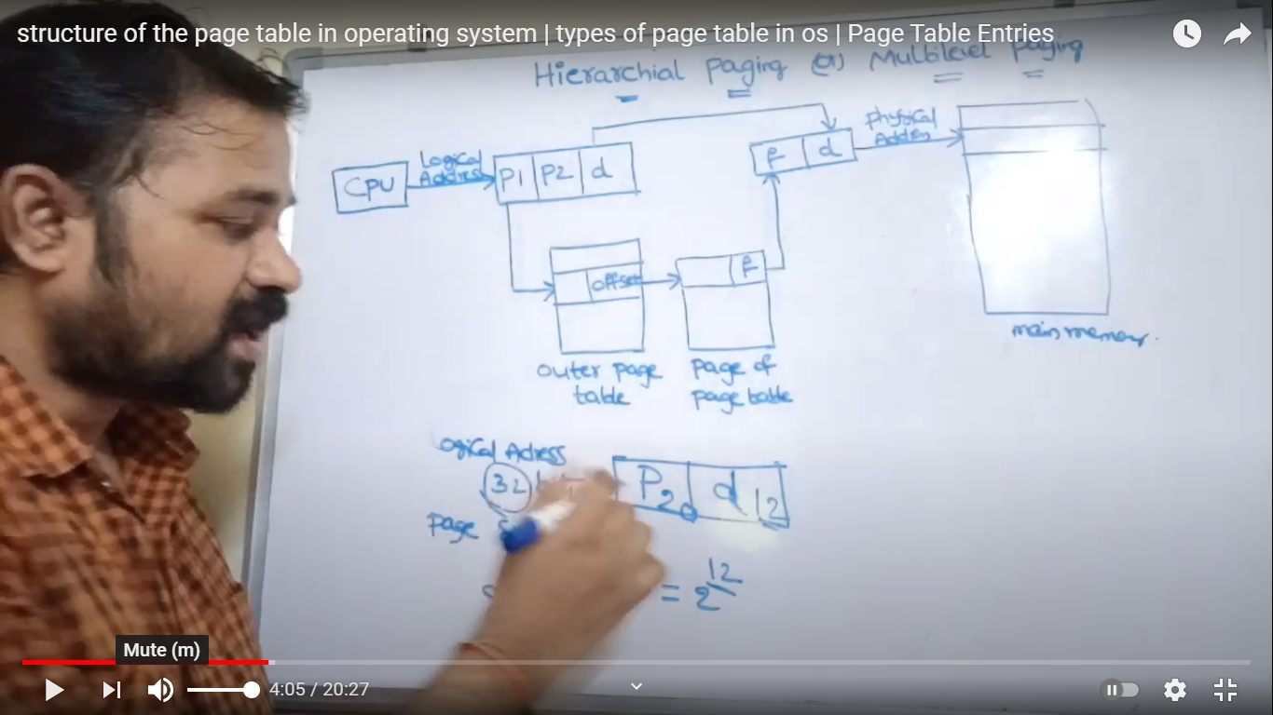
In Hierarchical Paging instead of storing entire page table information in one page table we are splitting that information among multiple page tables.
One page table contains some limited of information ,remaining information is available in another page table.
L
Let p1 size is 10 bits and P2 size is 10 bits, and displacement is 12 bits
P1 is given as index input to the outermost page table.
This page table accepts the page number as the input and it produces the offset.
Offset is given as index to the next page table.
This page table produces frame number as the output.
We combine frame number with this offset will give physical address in the main memory.
This is known as Two-level paging

Slide 27
Virtual Memory Techniques
Virtual Memory is a storage mechanism which offers user an illusion of having a very big main memory. It is done by treating a part of secondary memory as the main memory.
In Virtual memory, the user can store processes with a bigger size than the available main memory.
Therefore, instead of loading one long process in the main memory, the OS loads the various parts of more than one process in the main memory.
Virtual memory is mostly implemented with demand paging and demand segmentation.
Why Need Virtual Memory?
Whenever your computer doesn't have space in the physical memory it writes what it needs to remember to the hard disk in a swap file as virtual memory.

Slide 28
How Virtual Memory Works?
In the modern world, virtual memory has become quite common these days.
It is used whenever some pages require to be loaded in the main memory for the execution, and the memory is not available for those many pages.
So, in that case, instead of preventing pages from entering in the main memory, the OS searches for the RAM space that are minimum used in the recent times or that are not referenced into the secondary memory to make the space for the new pages in the main memory.
For example:
Let's assume that an OS requires 300 MB of memory to store all the running programs. However, there's currently only 50 MB of available physical memory stored on the RAM.
The OS will then set up 250 MB of virtual memory and use a program called the Virtual Memory Manager(VMM) to manage that 250 MB.
So, in this case, the VMM will create a file on the hard disk that is 250 MB in size to store extra memory that is required.
The OS will now proceed to address memory as it considers 300 MB of real memory stored in the RAM, even if only 50 MB space is available.
It is the job of the VMM to manage 300 MB memory even if just 50 MB of real memory space is available.

Slide 29
PAGE REPLACEMENT ALGORITHMS
Whenever page fault occurs and there are no free frames in memory, the operating system has to choose a page to remove from main memory in order to make a space for a new page coming from disk,
Though it is simple to remove a random page from main memory, the system performance would be much better if a page is less heavily used is removed from main memory.
This is because if a heavily used page is removed from main memory then there is a possibility that the heavily used page may be needed in the future and thereby the number of page faults will increase.
There are several page replacement algorithms. The performance of any algorithm is considered, depending on the number of page faults generated, lesser the page faults and more the efficient algorithm is.
FIFO (First in First out)
The simplest page replacement algorithm is FIFO replacement algorithm. Here O.S. maintains queue whose elements indicates the page number present in main memory.
The top of the queue denotes oldest page (i.e .First in page) and bottom of the queue denotes the page that is recently entered in main memory (i.e. last in page).
Whenever, there is a page faults occur and there are no free frames then the first in page is removed i.e. the page at the top of the queue is removed and the new page is inserted at the bottom of the queue.

Slide 30
Consider a page reference string
7 0 1 2 0 3 0 4 2 3 0 3 2 1 2 0 1 7 0 1
Here the most heavily used page is ‘0’ and the least heavily used page is 4.
Let us assume there are three frames in main memory, then the algorithm works as follows.
Thus this algorithm produces 15 page faults. This algorithm is easy to understand and easy to implement but efficient point of view, this algorithm is not good. This is because if a heavily used page is at the top of queue then FIFO algorithm replaces this page when there is page fault. Since this page is heavily used there is a probability of that page being referred again in future. Thus FIFO algorithm is inefficient when a heavily used page is at the top of the queue.

Slide 31
Belady’s Anamoly
Generally, on increasing the number of frames to a process’ virtual memory, its execution becomes faster as less number of page faults occur. Sometimes the reverse happens, i.e. more number of page faults occur when more frames are allocated to a process. This most unexpected result is termed as Belady’s Anomaly.
Bélády’s anomaly is the name given to the phenomenon where increasing the number of page frames results in an increase in the number of page faults for a given memory access pattern.
Belady’s anomaly occurs only in First come first serve page replace ment algorithm

Slide 32
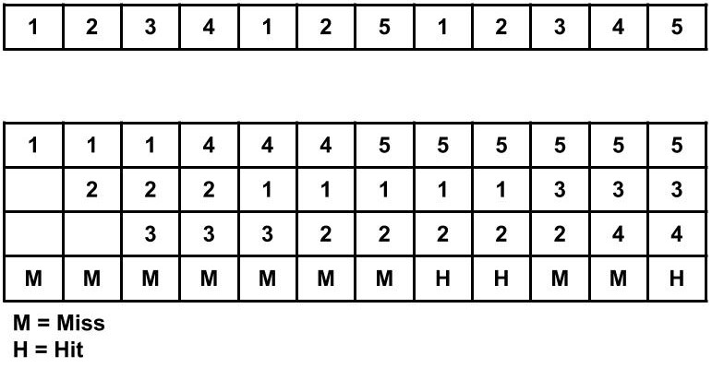
Consider the page reference string of size 12: 1, 2, 3, 4, 1, 2, 5, 1, 2, 3, 4, 5 with frame size 3(i.e. maximum 3 pages in a frame).
Total Page Fault = 9

Slide 33
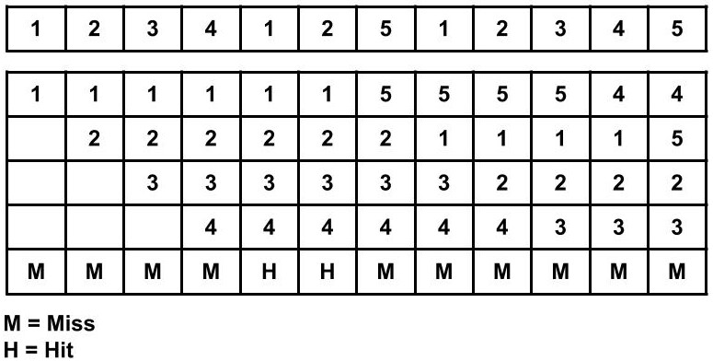
Now, let's see what happens when we increase the frame size from 3 to 4.
Total Page Fault = 10

Slide 34
Optimal Replacement Algorithm (ORA):
The technique in ORA is remove a page which is not referred immediately i.e. replace a page that is not used for a longest period of time. This algorithm guarantees the lowest possible page faults rate for a fixed no. of framed.
Example: Consider a page replacement string
7 0 1 2 0 3 0 4 2 3 0.3 2 1 2 0 1 7 0 1
Assume that there are 3 frames in main memory
This algorithm produces 9 page faults and considered to be an efficient algorithms compared to the remaining algorithm. If the number of frames increases then number of page faults will decrease and program execution becomes faster this algorithm is difficult to implement. Since it requires future knowledge of the page reference string.

Slide 35
LRU (Least Recently Used)
This algorithm keeps track of transactions in main memory. Whenever, a page faults occurs and if there are no free frames.
Operating system checks for the page that is not used for the longest time and marks this page for replacement.
The idea is that if a page is not used for a long time, then we preassume that the page will not be used in the future and hence mark that page for replacement.
In other words, if a page is referred just now, then we preassume that it may be used again in the future and hence do not replace that page.
LRU is almost similar to ORA he only difference is that ORA looks forward the page reference string to check which page is not referred in the near future but LRU looks backward the page reference string to check which page is not referred for a long time.
Consider the page reference string
7 0 1 2 0 3 0 4 2 3 0 3 2 1 2 0 1 7 0 1

Slide 36
Consider the page reference string
7 0 1 2 0 3 0 4 2 3 0 3 2 1 2 0 1 7 0 1
Here top of queue denotes LRU page (long time back used) bottom of the queue denotes MRU page (page which is just now referred) whenever there is a page fault top of queue will be deleted and new page goes to bottom of queue.

Slide 37
Allocation of Frames
Frame allocation algorithms are used if you have multiple processes; it helps decide how many frames to allocate to each process.
Frame allocation algorithms – The two algorithms commonly used to allocate frames to a process are:
Equal allocation: In a system with x frames and y processes, each process gets equal number of frames, i.e. x/y. For instance, if the system has 48 frames and 9 processes, each process will get 5 frames. The three frames which are not allocated to any process can be used as a free-frame buffer pool.
Disadvantage: In systems with processes of varying sizes, it does not make much sense to give each process equal frames. Allocation of a large number of frames to a small process will eventually lead to the wastage of a large number of allocated unused frames.
2. Proportional allocation: Frames are allocated to each process according to the process size.
For instance, in a system with 62 frames, if there is a process of 10KB and another process of 127KB, then the first process will be allocated (10/137)*62 = 4 frames and the other process will get (127/137)*62 = 57 frames.

Slide 38
Local and Global Replacement
Let there be three processes A, B, C. present in main memory. Suppose process A gets a page fault then O.S looks at only A pages i.e. A process and the page with lowest age is replaced which is A3.
This is called local replacement. Thus in local replacement the number of frames allocated to each process is constant. (i.e. as long as process A is executing there will be three frames for it, as long as process B is executing there will be only 4 frames. As long as C is executing there will be only 2 frames.
Thus in local replacement, the page to replace from core should belong to same Job as that of page coming in.
A1 | 7
A2 | 5
A3 | 4
B1 | 6
B2 | 5
B3 | 3
B4 | 8
C1 | 6
C2 | 4

Slide 39
On the other hand if the page, if the lowest age is removed without regard to which Job it belongs then this replacement is called global replacement. Thus in global replacement when process ‘A’ gets a page fault then O.S looks for the page with the lowest age. This is B3. Hence B3 is replaced by A page i.e. A4.
There is a disadvantage in global replacement i.e. as the page of other Jobs are selected for replacement other Jobs start execution. The page fault for them increases. A situation may arise where in always pages of other Jobs are selected for replacement in which case all the pages present in main memory may belong to a single Job which is not desirable. In general if the global replacement is employed then the page fault rate goes beyond control.

Slide 40
Thrashing
The set of pages that a process is currently using called as working set. If the entire working set is in main memory then the process will run without causing any page fault ,
If the available memory is too small to hold the entire working set then the process will cause too many page faults and run very slowly.
A program causing page fault every few instruction is said to be thrashing i.e. a process is thrashing if it is spending more time for paging (swapping in and out) than executing.
For effective CPU utilization, the degree of multiprogramming (no. of user programs in RAM) should be increased. Thus main memory will contain more number of user programs. So each user program will occupy a small portion of main memory.
When a process starts execution it needs more frames (i.e. memory) and hence generates page fault. Let us assume global replacement algorithm is employed, in such a case the process takes frames of other Jobs and when those programs start executing, they also generates page fault and so on. .
As they queue up for paging device the ready queue (Job pool) become empty and device queue may become heavy and there by the CPU utilization drops

Slide 41
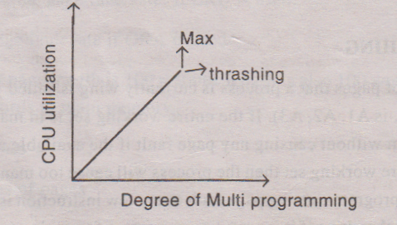
Now operating system sees the decreasing CPU utilization and increase the degree of multiprogramming by selecting a new process and loads in Ready queue.
Since the memory is already occupied with other process page when the new process starts execution it also generates page faults. Thus the CPU utilization has dropped even further.
A situation may arise where in the device queue goes on increasing drastically as new Jobs are selected for better CPU utilization and ready queue becomes empty and situation goes out of control.
This is called thrashing because of thrashing no working is getting done because process are spending more time in paging than executing.
Graph
From this graph, we understand that as the multiprogramming increases, CPU utilization also increases once maximum CPU utilization reached, the degree of multiprogramming should not be increased. If we increase thrashing occurs and CPU utilization drops. To avoid thrashing minimum number of Jobs must be selected in the RAM which gives better CPU utilization.

Slide 42
Secondary Storage Management
Secondary storage devices are those devices whose memory is non volatile, meaning, the stored data will be intact even if the system is turned off. Here are a few things worth noting about secondary storage.
Secondary storage is also called auxiliary storage.
Secondary storage is less expensive when compared to primary memory like RAMs.
The speed of the secondary storage is also lesser than that of primary storage.
Hence, the data which is less frequently accessed is kept in the secondary storage.
A few examples are magnetic disks, magnetic tapes e.tc

Slide 43
Disk Structure
In modern computers, most of the secondary storage is in the form of magnetic disks. Hence, knowing the structure of a magnetic disk is necessary to understand how the data in the disk is accessed by the computer.
A magnetic disk contains several platters. Each platter is divided into circular shaped tracks.
Each track is further divided into sectors, as shown in the figure.

Slide 44
The red circle is a track, you'll have many tracks. A sector is shown in purple. You should also note that the disk will be rotating and there's a head which reads from the rotating disk.
Let us label the tracks from 0 (innermost, inside red circle) to 3 (outermost circular strip). Similarly the purple sector as 0 and going clockwise we name the others till 7. For our convenience we can refer (x,y) as the track sector whose track is x and sector is y.

Slide 45
Seek time is the time taken by the arm to move to the required track.
Rotational latency is defined as the time taken by the arm to reach the required sector in the track.
Example
Say you're reading some data from the (0,4). You receive instructions to read from track (2,5). The time it takes for you to move from track 0 to track 2 is seek time.
Once you reach track 2, you realize the head is above the 1st sector you'll have to wait till the disk rotates to the 5th sector so that you can start reading from (2,5). The time you wait for the sector to be accessible by your head here is known as latency.
We can reduce the seek time by using Different Disk Scheduling algorithms

